Slide 1

MAFS5130 Project: time series model for explainable price action trading strategy
WONG Yan Kit
21127344

Slide 2
3 QUESTIONS TO BE FORCUS ON…
Can Time Series Models forecast the value that allow trading in better risk-adjusted return?
Do Multivariate Time Series model with Marco Time Series data help forecasting better?
How well is the generalization ability for Time Series Model?

Slide 3
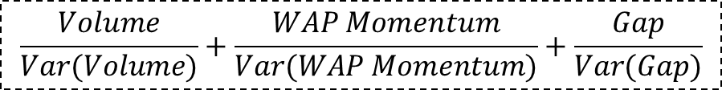
Part 1: Trading framework
Timeframe: daily, weekly, monthly
Time range: 2019-1-1 to 2024-12-31
DOWJ Stock Components
Stock A
Buy at Open, Sell at Close
Time series Data
Price Action Score
Trading
Volume
WAP Momentum
Open-Close Price Gap
For each stock, calculate…
Stock B
Long Top 5
Conditional Mean: ARMA Model
Conditional Volatility:
GARCH Model
…
Stock N
$$\frac{Volume}{Var(Volume)}+\frac{WAP Momentum}{Var(WAP Momentum)}+\frac{Gap}{Var(Gap)}$$
Parametric
Time Series Model
Objective: Identify the stocks that have strong momentum and high liquidity, with lower volatility
to trade in better risk-adjusted return using forecasted time series values

Slide 4
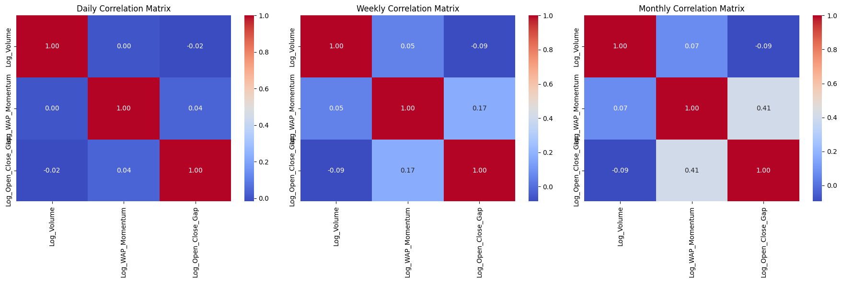

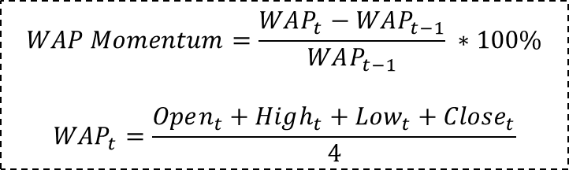
Data preprocessing
$$WAP Momentum=\frac{WAP_{t}−WAP_{t−1}}{WAP_{t−1}} ∗100\%$$
$${WAP}_{t}=\frac{Open_{t}+High_{t}+Low_{t}+Close_{t}}{4}$$
Low Correlation -> low information overlapping
WAP Momentum
Trading
Volume
Open-Close Price Gap
$Price {Gap}_{t}=\frac{Close_{t}−Open_{t}}{Open_{t}}∗100$

Slide 5
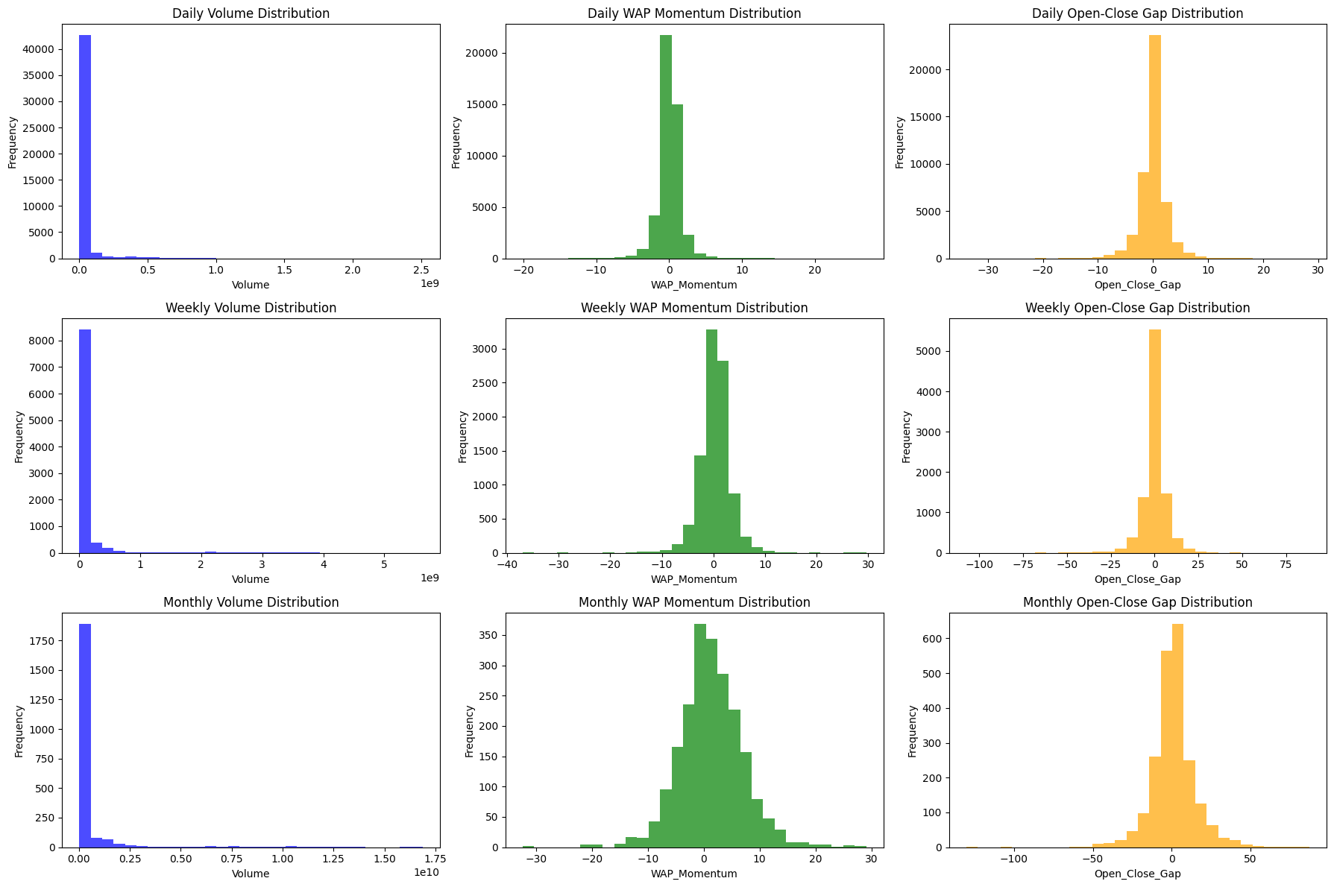
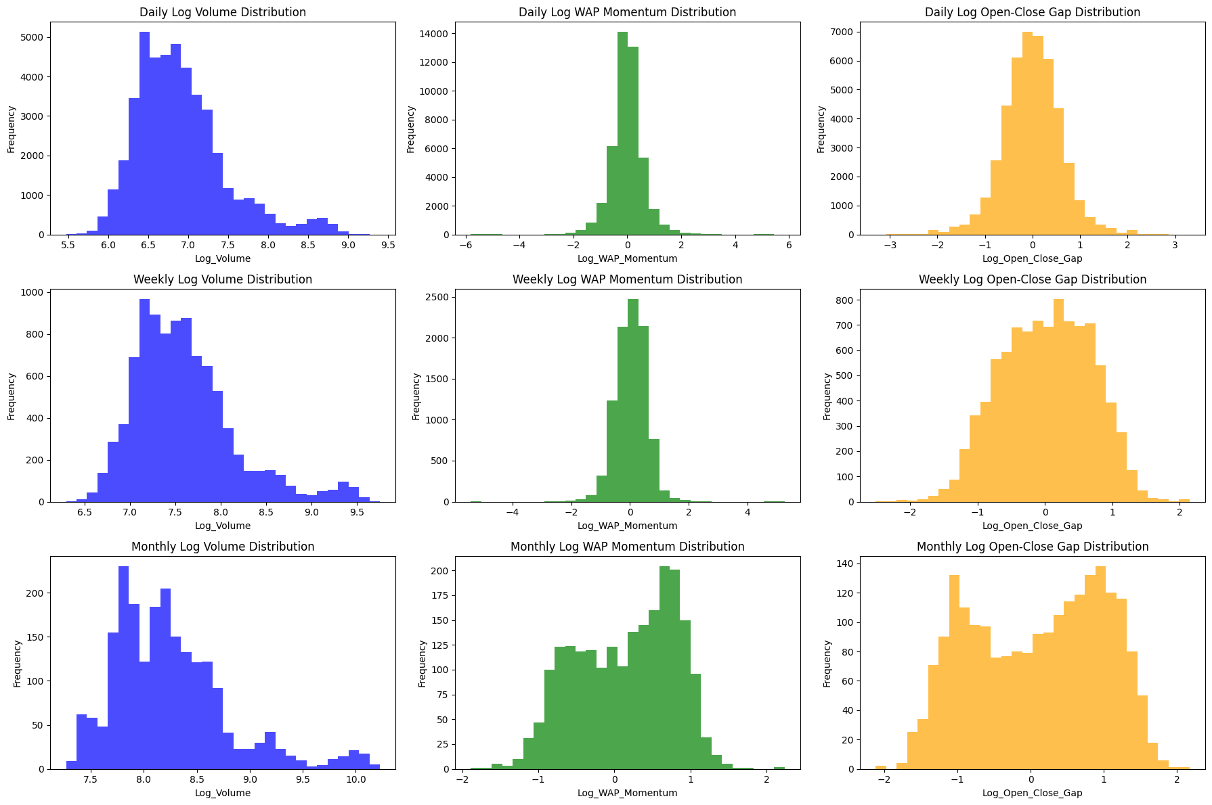
The distribution
Apply
log scale
Wide range
High skewness
Log Volume
Log WAP Momentum
Log Open-Close Gap

Slide 6



Testing for non-stationarity , arch effect & model building
For each stock,
For time series, test…
ACF/PACF & AIC
Residual Analysis
Used to forecast conditional mean and conditional variance
for Log WAP Momentum, Lop Open-Close Gap, Log Volume
Stock 1
Stock 2
…
Stock N
Log WAP Momentum
Log Open-Close Gap
Log Volume
Non-stationarity
ARMA/ARIMA
$E(x_{t+1}|x_{t}, …, x_{0})$
ARCH Effect
GARCH
g$(σ_{t+1}^{2}|ε_{t}, …, ε_{0};σ_{t}^{2},…,σ_{0}^{2})$
ADF Test
ARCH LM Test
Model Parameter Estimation:
Maximum Likelihood Estimator
1 year is for:
Testing non-stationarity & ARCH effect
Model specification & parameter estimation
$y_{t}=\left(1−B\right)x_{t} for ARIMA$
$x_{t}= ∅_{1}x_{t−1}+…+∅_{p}x_{p}+θ_{1}ε_{t−1}+…+θ_{q}ε_{q}$
$$σ_{t}^{2}= {α_{0}+α}_{1}ε_{t−1}+…+α_{p}ε_{p}+β_{1}σ_{t−1}+…+β_{q}σ_{q}$$
2019-1-1 to 2019-12-31
2020-1-1 to 2024-12-31
5 years is for:
Back testing & Forecasting

Slide 7
Non-stationarity & arch effect result
Num of stock that are stationary | Log_Open_Close_Gap | Log_Volume | Log_WAP_Momentum
Daily | 30 | 30 | 30
Weekly | 15 | 11 | 18
Monthly | 27 | 27 | 28
Num of stock that has ARCH Effect | Log_Open_Close_Gap | Log_Volume | Log_WAP_Momentum
Daily | 3 | 30 | 2
Weekly | 0 | 3 | 1
Monthly | 0 | 0 | 0
(out of 30 stocks)

Slide 8
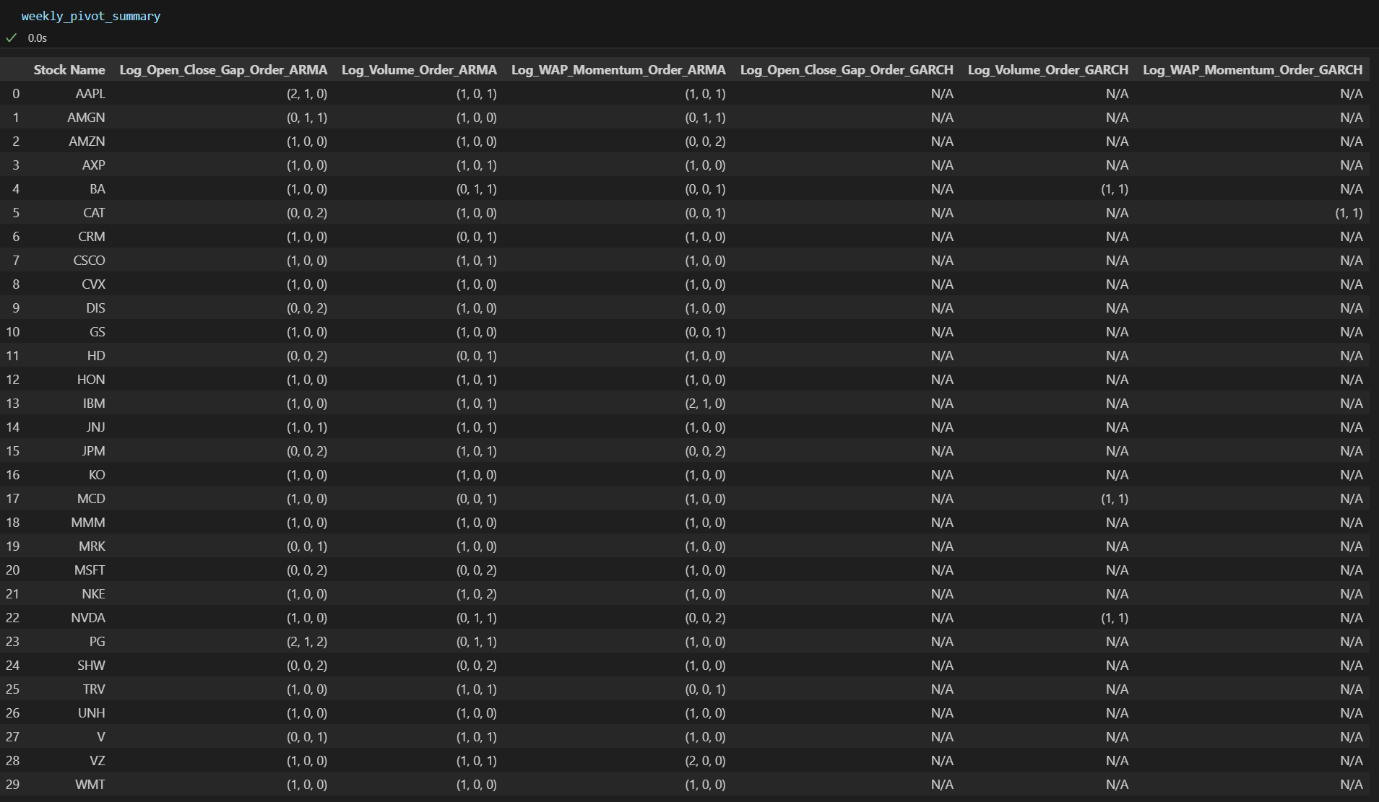
Arma & GRACH MODEL RESULT
weekly result as an example

Slide 9
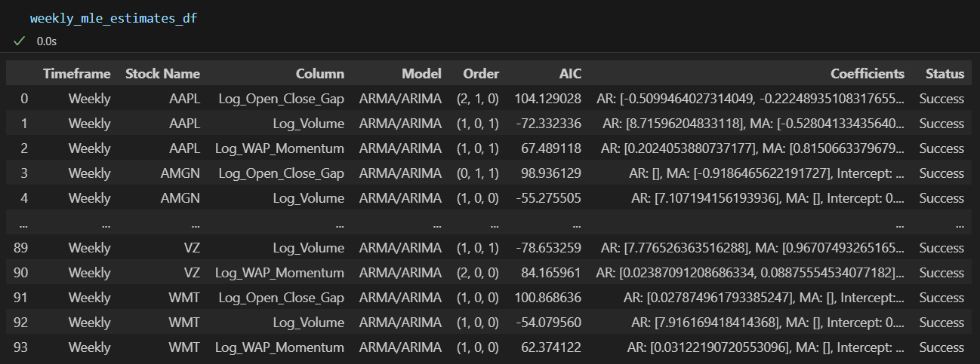
Coefficient estimation by mle
weekly result as an example

Slide 10
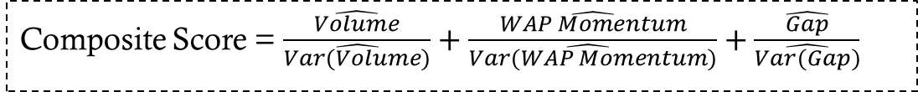
training & forecasting
Stock A
Composite Score = $\frac{\hat{Volume}}{\hat{Var(Volume)}}+\frac{\hat{WAP Momentum}}{\hat{Var(WAP Momentum})}+\frac{\hat{Gap}}{\hat{Var(Gap)}}$
Stock B
…
$$Conditional Mean: \hat{Volume},\hat{WAP Momentum}, \hat{Gap}$$
Forecast Value
Stock N
$$Conditional Variance: \hat{Var(Volume)},\hat{Var(WAP Momentum)}, \hat{Var(Gap)}$$
Training Period for model fitting
In each datetime point,
it has Price Action score from
forecast value…
5 years is for:
Back testing & Forecasting
Long 5 Stocks with highest price action score
(each owns 20% of position)
2019-1-1 to 2019-12-31
2020-1-1 to 2024-12-31
For each datetime,
Buy at Open, Sell at Close
Return = Close - Open

Slide 11
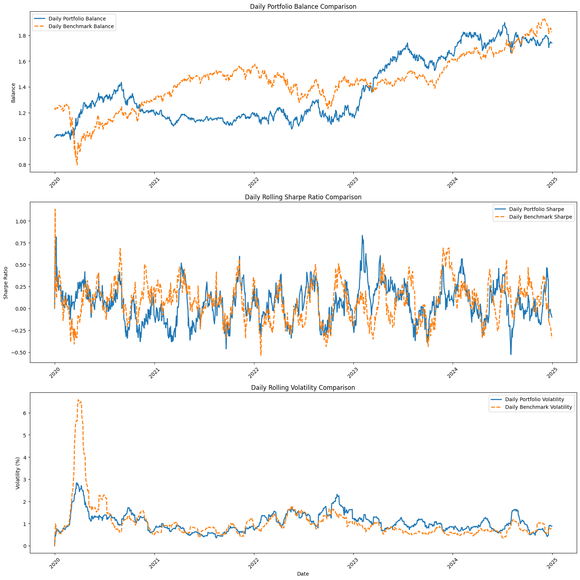
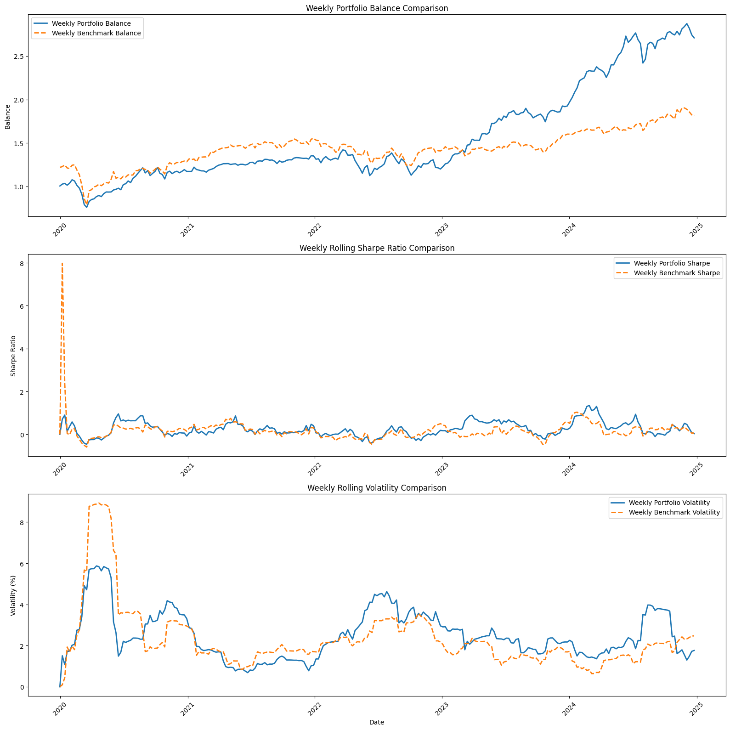
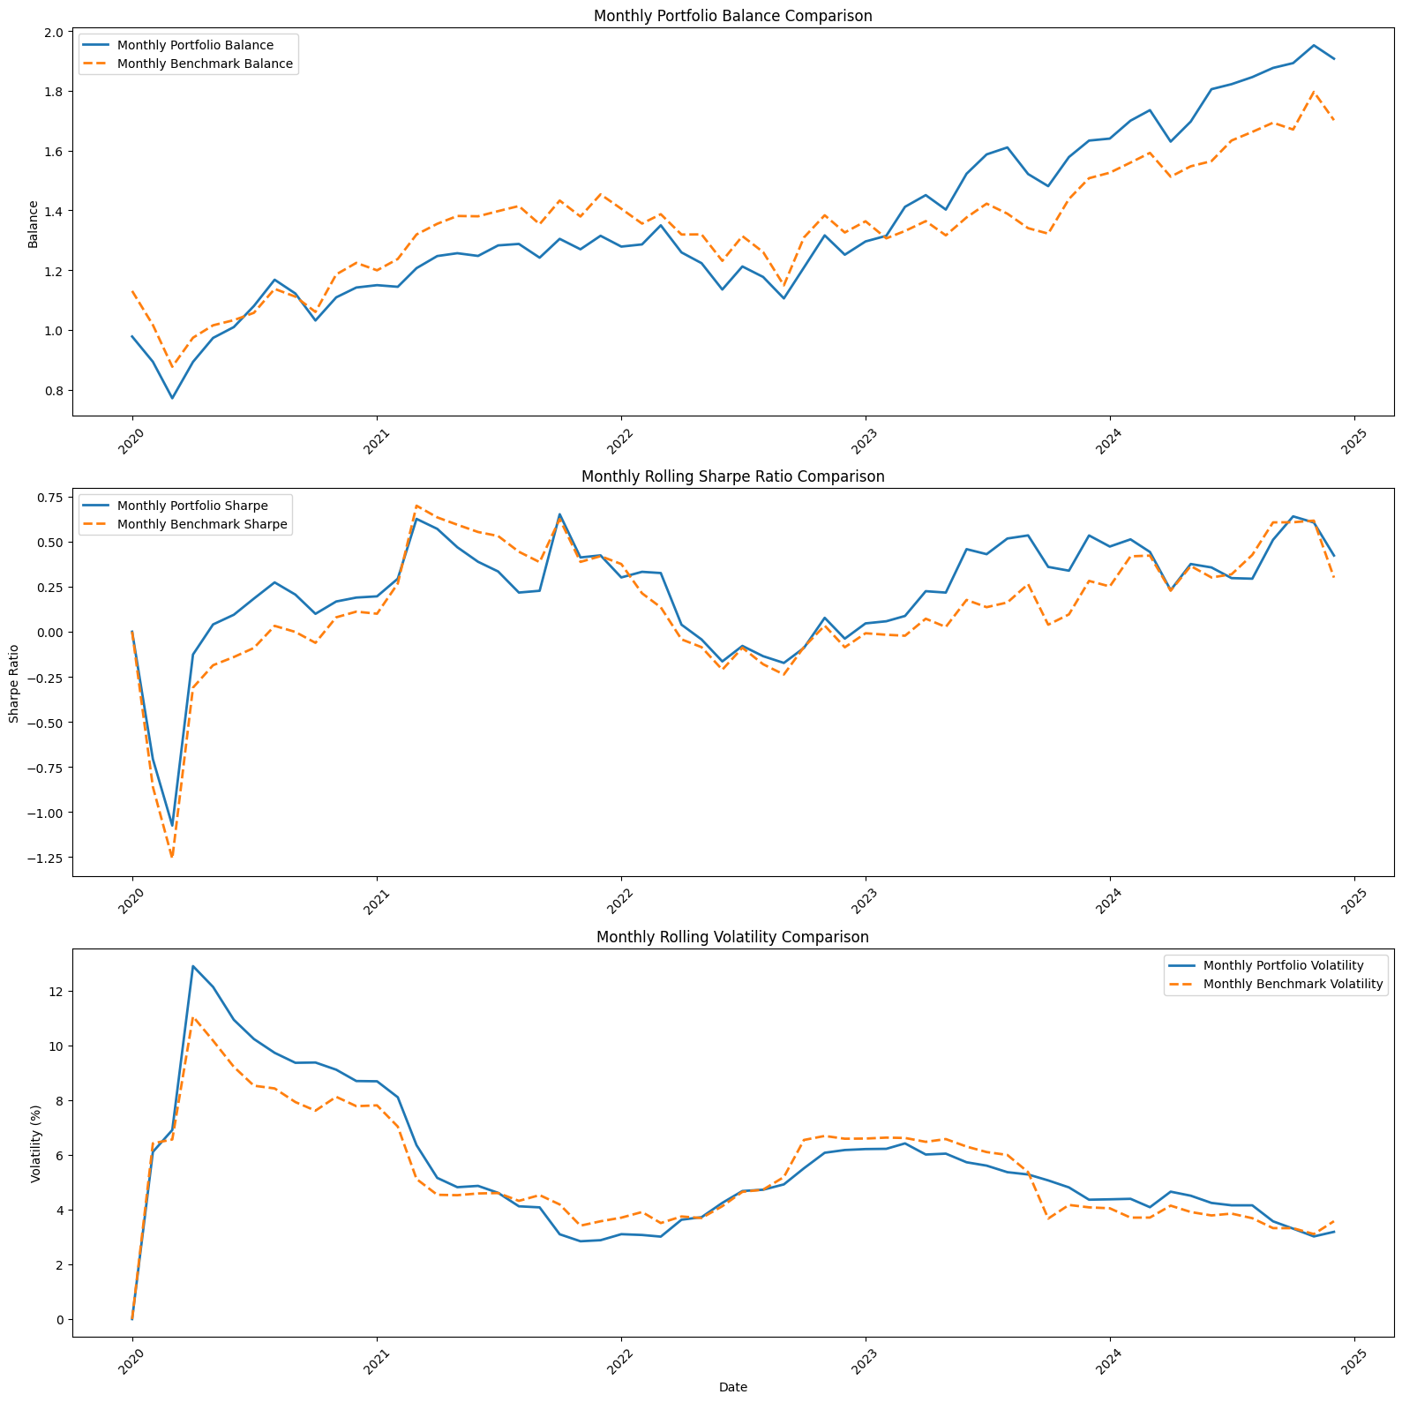
performance
 | CAGR | Annualized Sharpe Ratio | Annualized Volatility
Daily Portfolio | 11.72% | 0.61 | 17.96%
Daily Benchmark | 12.77% | 0.38 | 20.88%
Weekly Portfolio | 22.13% | 0.99 | 19.99%
Weekly Benchmark | 12.64% | 0.39 | 19.92%
Monthly Portfolio | 14.04% | 0.72 | 18.57%
Monthly Benchmark | 11.42% | 0.45 | 18.21%
Conclusion:
Time Series model help better explainable forecasting
to achieve higher-risk-adjusted return
The best timeframe for time series model:
Among all Portfolios: Weekly
Outperform the benchmark the highest: Weekly

Slide 12
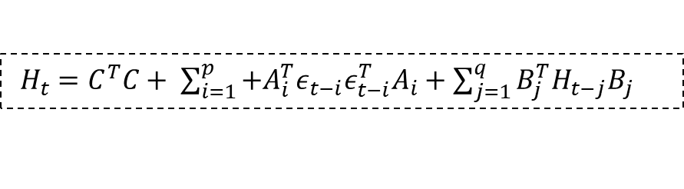
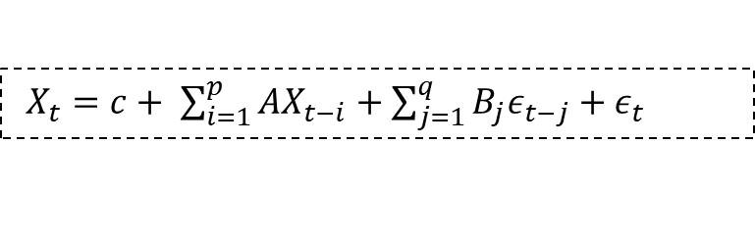
Part 2: Do Multivariate Time Series model with Marco Time Series data help better forecasting?
$X_{t}=c+ \sum_{i=1}^{p}{AX_{t−i}+\sum_{j=1}^{q}{B_{j}ε_{t−j}+ε_{t}} }$
But using…
Multivariate VARMA
Two Types:
With Yield Curve
Without Yield Curve
Same framework setting in Part 1
Different vector elements
Multivariate GARCH
$H_{t}=C^{T}C+ \sum_{i=1}^{p}{+A_{i}^{T}ε_{t−i}ε_{t−i}^{T}A_{i}+\sum_{j=1}^{q}{B_{j}^{T}H_{t−j}B_{j}} }$
Different Price Action score
cross-variable coefficient allows
the joint dynamic between different time series

Slide 13
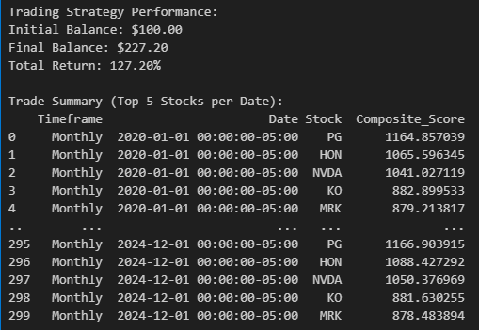
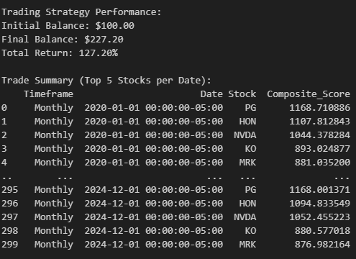
Trading strategy comparison
Same Top Stocks selection but with difference Price Action score
With Yield Curve
Without Yield Curve

Slide 14
Increment of the composite score by adding yield curve time series
Stock A
For each datetime,
Buy at Open, Sell at Close
Return = Close - Open
Date | Price Action score with Yield | Price Action without Yield | Increment of Price Action (%)
2020-1-1 | 102 | 100 | 2%
2020-1-2 | 102 | 105 | -2.85%
… | … | … | …
Stock B
Long 5 Stocks with highest Increment of Price Action (%)
…
Stock N
Increment of price action score represents the effect of adding Yield Curve

Slide 15
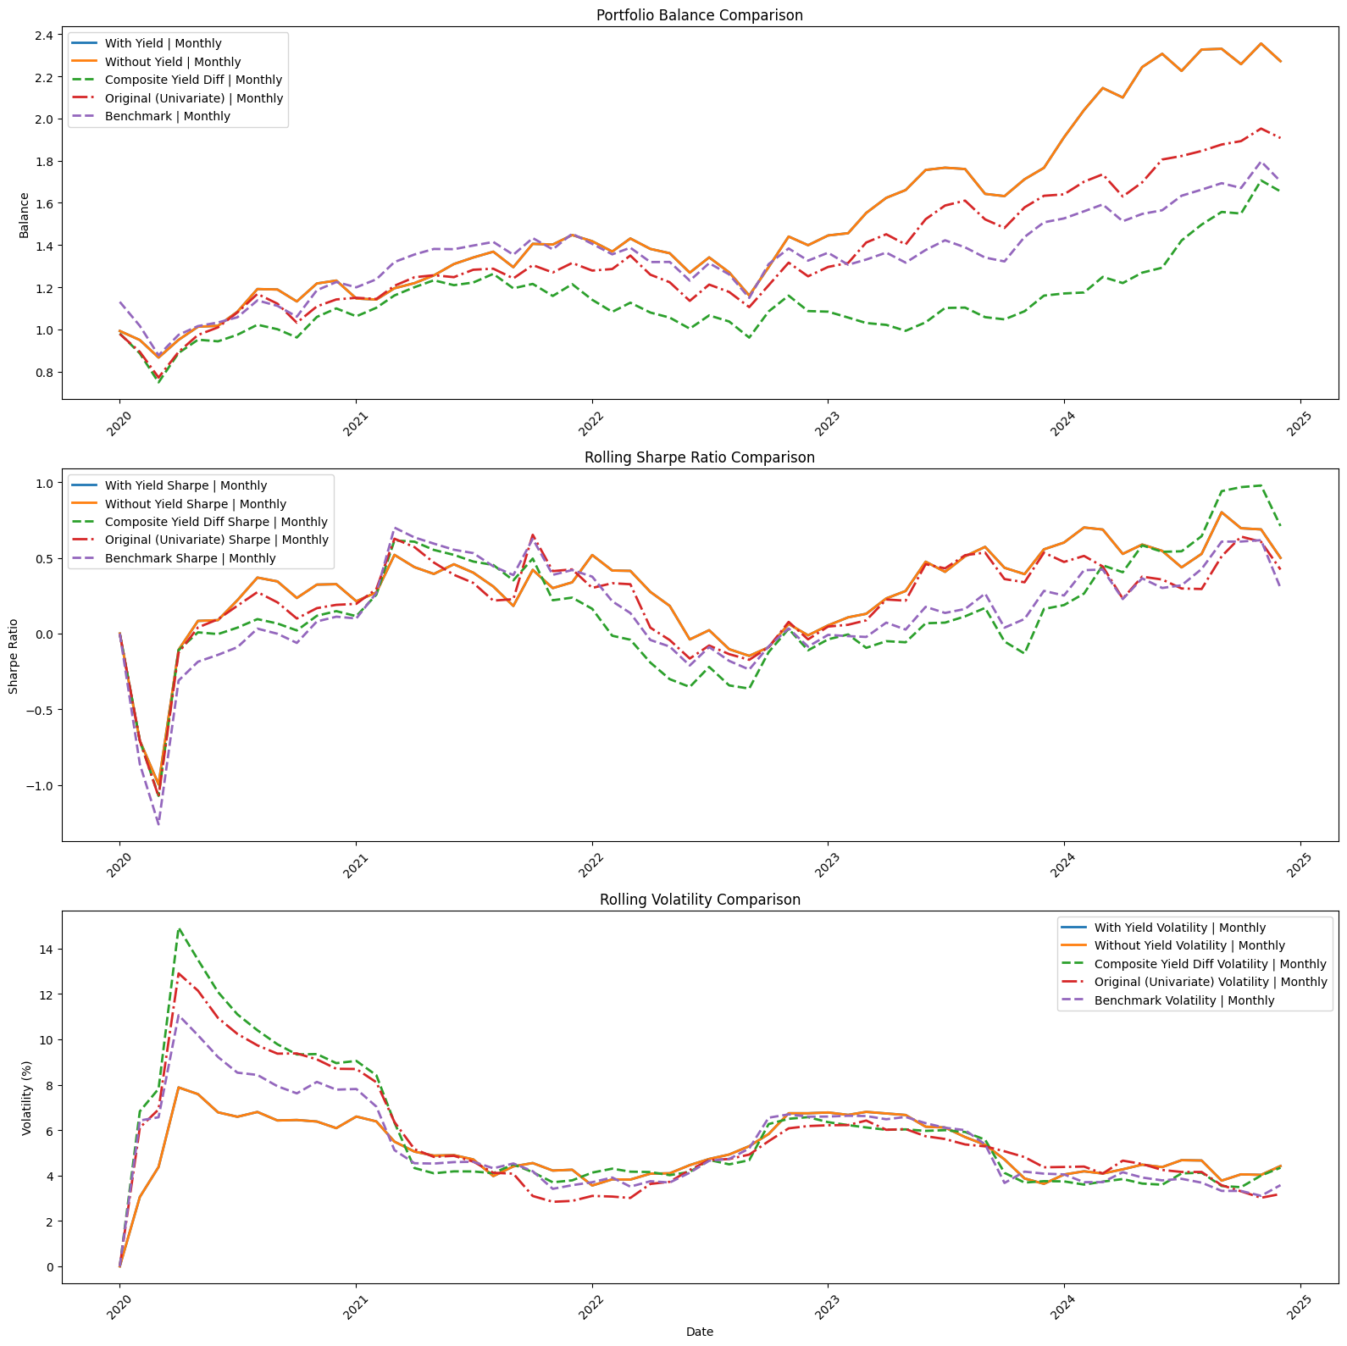
performance
 | CAGR | Annualized Sharpe Ratio | Annualized Volatility
Multivariate Model | 18.16% | 0.96 | 17.34%
Price action score difference | 10.78% | 0.53 | 19.81%
Univariate Model | 14.04% | 0.72 | 18.57%
Benchmark | 11.42% | 0.45 | 18.21%
Conclusion:
Multivariate Time Series model help better forecasting
compared to Univariate Time Series model & Benchmark.
While Marco Time Series does not provide significant improvement

Slide 16
Part 3: How well is the generalization ability for Time Series Model?
Timeframe | Training windows size | Testing windows size (forecast)
Daily | 252 days | 126 days
Weekly | 52 weeks | 26 weeks
Monthly | 12 months | 6 months
all forecasting point starting from
2020-1-1 to ensure fair comparison
Previous data to train model
with training window size
Testing windows
for forecasting
Moving Training & Forecasting windows
2019-1-1 to 2024-12-31

Slide 17
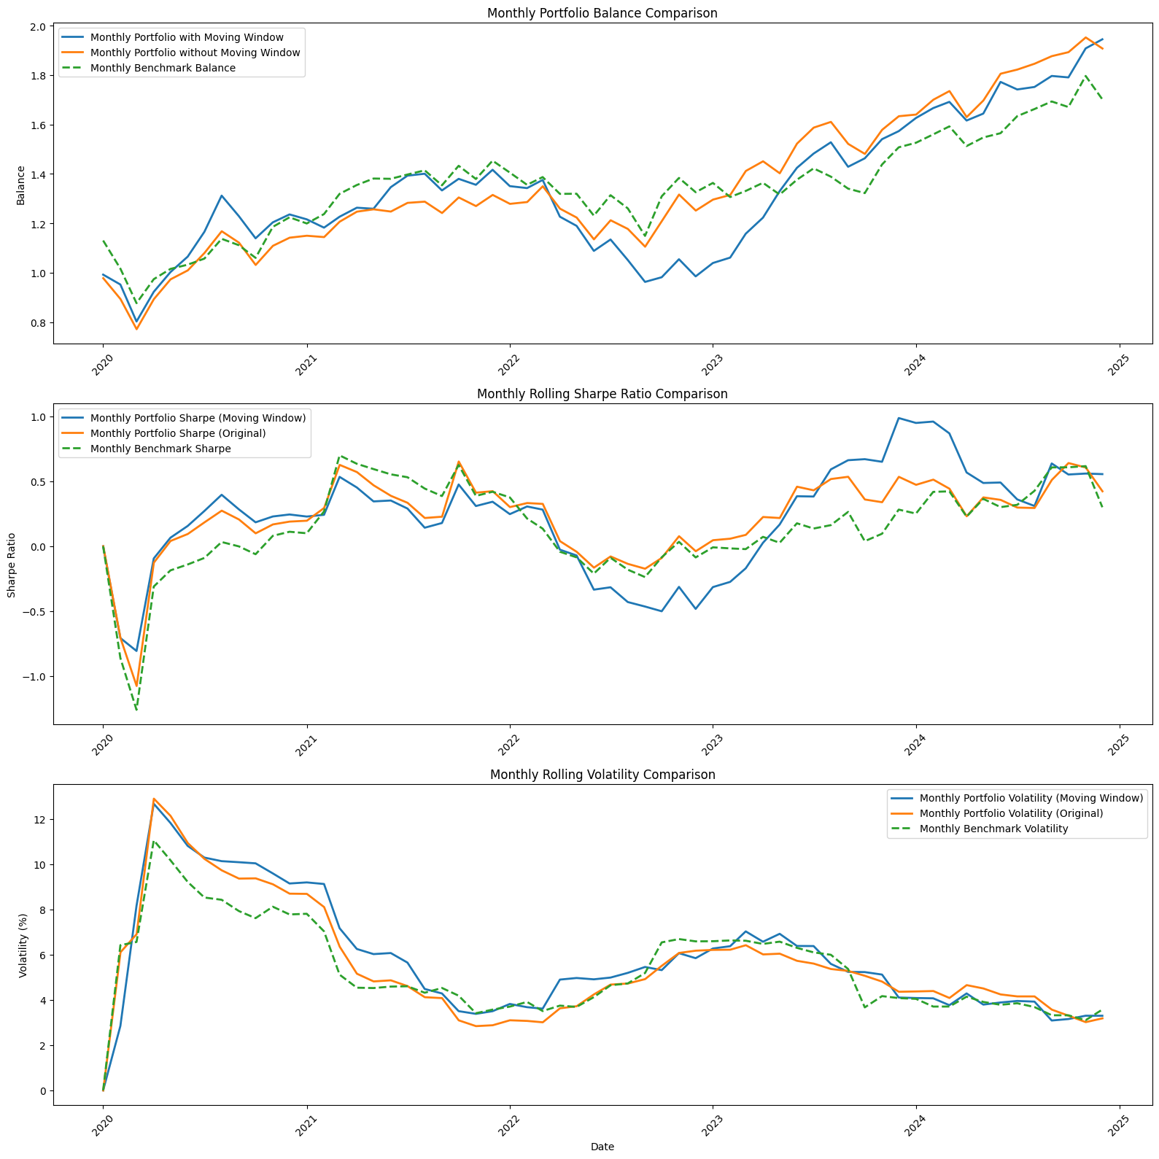
PERFORMANCE
 | CAGR | Annualized Sharpe Ratio | Annualized Volatility
Portfolio without moving windows | 14.04% | 0.72 | 17.34%
Portfolio with moving windows | 14.49% | 0.66 | 18.57%
Benchmark | 11.42% | 0.45 | 18.21%
Conclusion:
Without capturing the dynamic change of time series distribution,
the model achieve similar risk-adjusted return.
Hence the model have a robust generalization ability.

Slide 18
conclusion
Can Time Series Models forecast the value that allow trading in better risk-adjusted return?
Do Multivariate Time Series model with Marco Time Series data help forecasting better?
How well is the generalization ability for Time Series Model?
Yes
Yes
& No
Yes

Slide 19

The end

